Slide 1
Identifying Those Tricky Little Micro-moths
Paul J. Palmer

Slide 2
What Is A Micro-moth?
This is a tricky question to answer as there no taxonomic difference, as in butterflies and moths. Even that is a bit blurred.
So far as I can tell, the larger moths are those that were described in South vols 1 and 2 “The Moths of the British Isles”, and the rest are the micro-moths.
In the olden days when we used a light trap there we so many large moths that we were never tempted by the micros that were trampled by the Noctua pronuba (Large Yellow Underwing) which came in their hundreds.
Micros were collected by rearing out series collected off food plants and mines.
The first (and current) editions of “The Field Guide To The Smaller Lepidoptera” contain no illustrations of adult moths at all.

Slide 3
Wot! No Illustrations?
Don’t worry, I will use them later in this presentation.
Without illustrations the emphasis for identification rested on descriptions of the larval behaviour and food plants.
Adults were set and pinned as a “series”.
Just to emphasise, you had to be really proficient with your plant identification too.
My old copy of Clapham, Tutin, and Warburgh “The Excursion Flora Of The British Isle” was also without images.
To those of you only used to modern illustrated field guides this must sound very strange, but the point I make is that a good identification is based on a collection of evidence, not a match to an image.

Slide 4
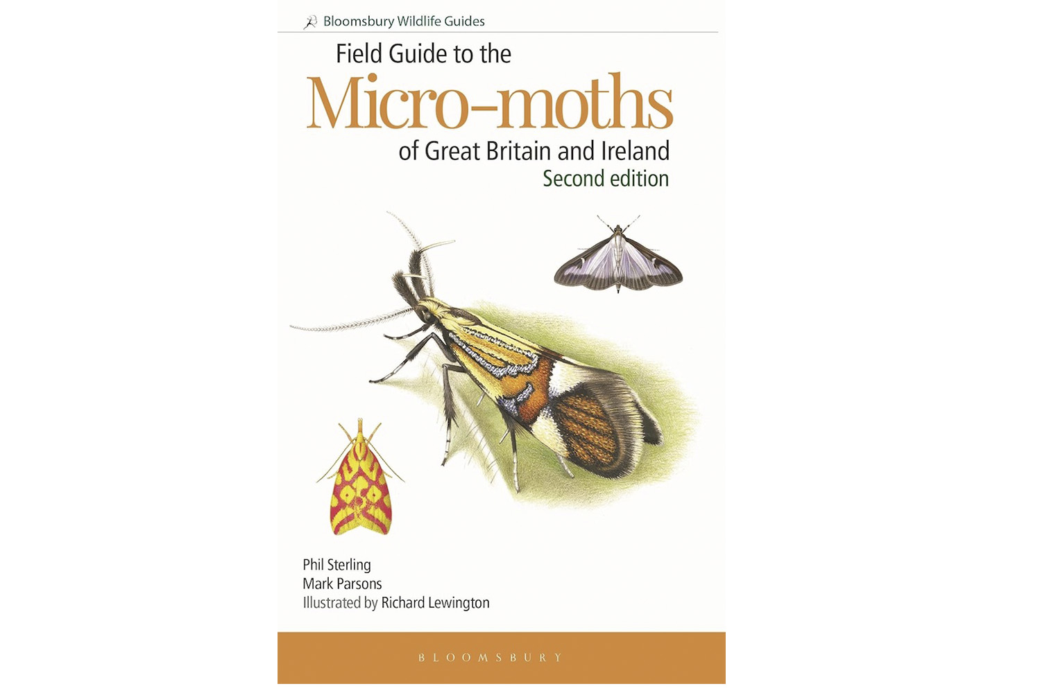
First Steps
Light traps catch fewer moths these days, so the micro-moths are more obvious.
The publication of the excellent illustrated ‘Field Guide to the Micro-Moths of Great Britain and Ireland’ has helped popularise this group further.
BUT, the temptation for beginners is to ‘pattern match’ from a field guide.
The availability of ‘Apps’ reinforces this approach.
Field Guide to the Micro-moths

Slide 5
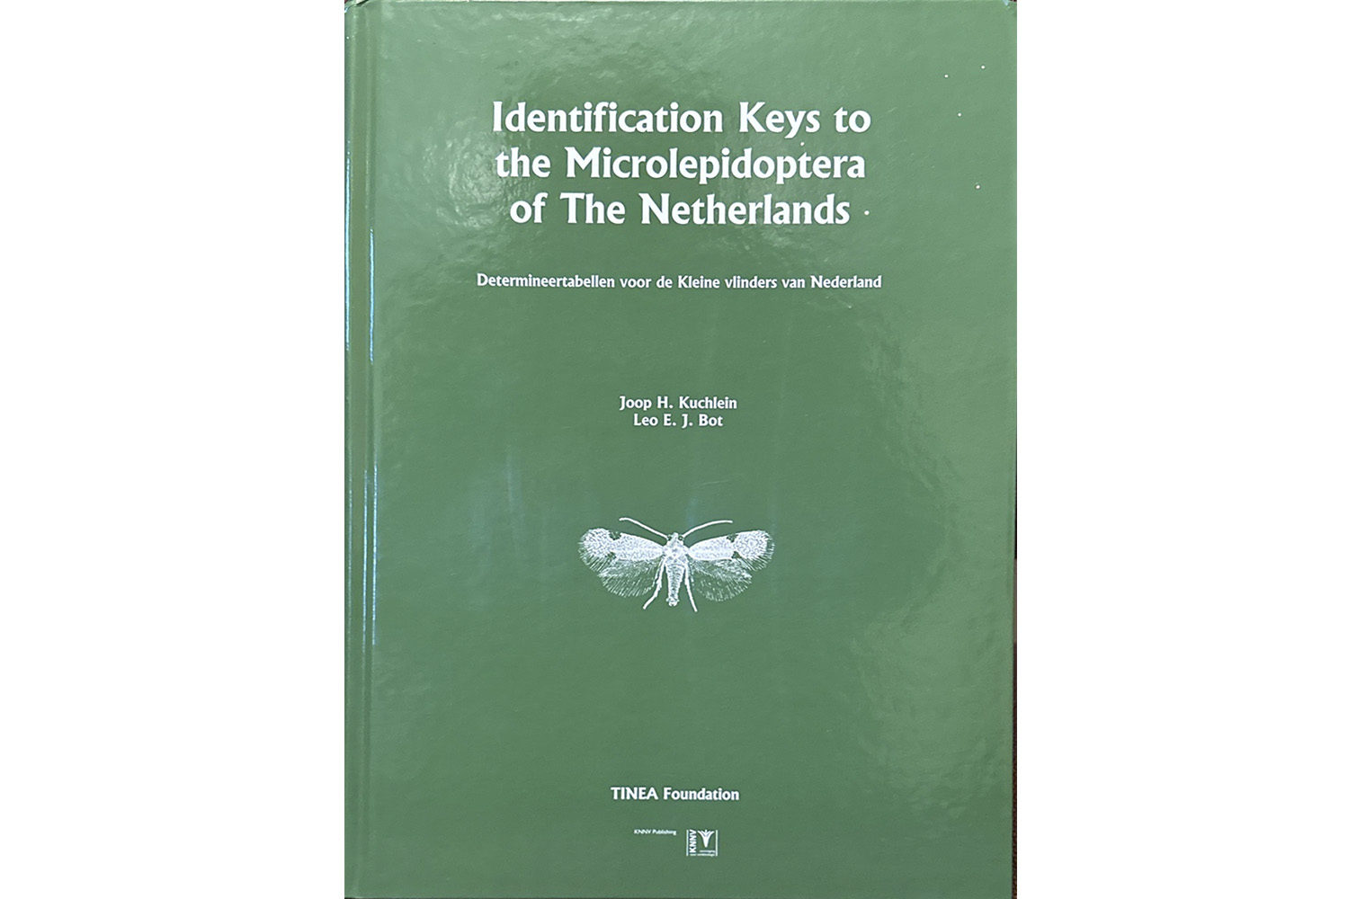
Identification Is A Process
Treat ID as process and start by writing down everything that you know and can see.
Examine your specimen closely.
Use these notes to try and work out the Family.
There is a good visual key to families in ‘Field Guide to the Micro-Moths of Great Britain and Ireland’.
Lepidoptera keys to species level are few and far between.
A key to the Micro-moths

Slide 6
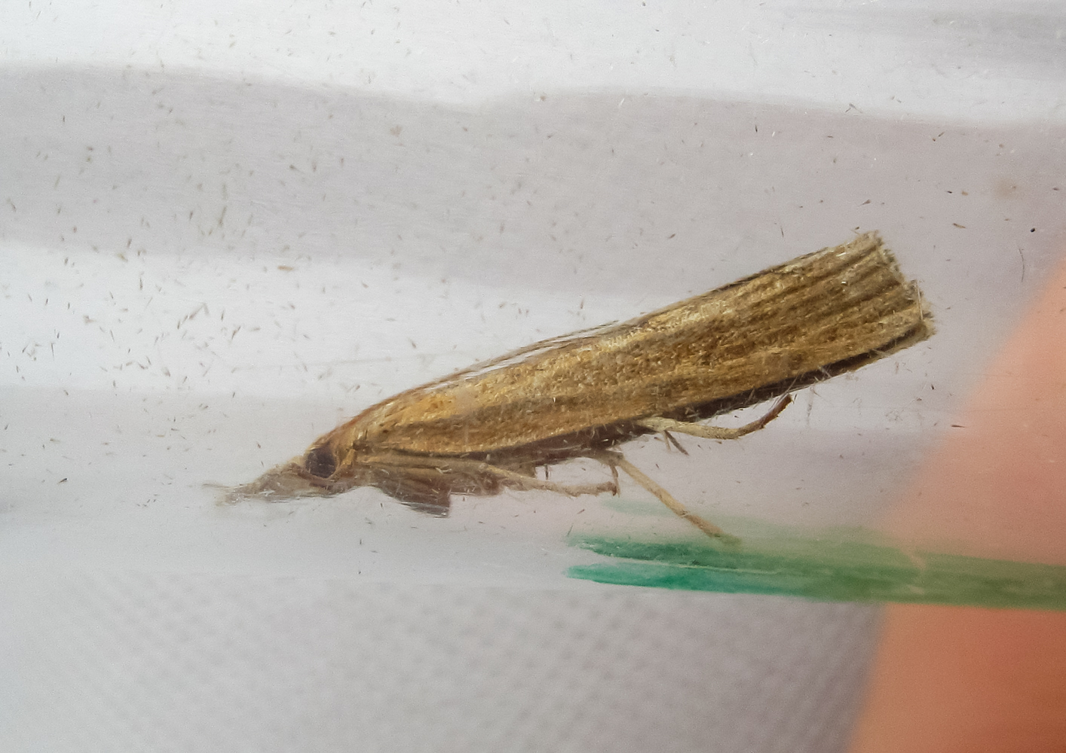
A Tricky Moth For ID
Making a list of candidate species is a tedious and time-consuming process.
You should now have a list that includes: size, locality and type of habitat; date; and other obvious features.
A photograph is also helpful - look at the posture and position of the antennae.
What can we see here?

Slide 7
We will illustrate the ID process by following one moth tricky moth through its journey.

Slide 8
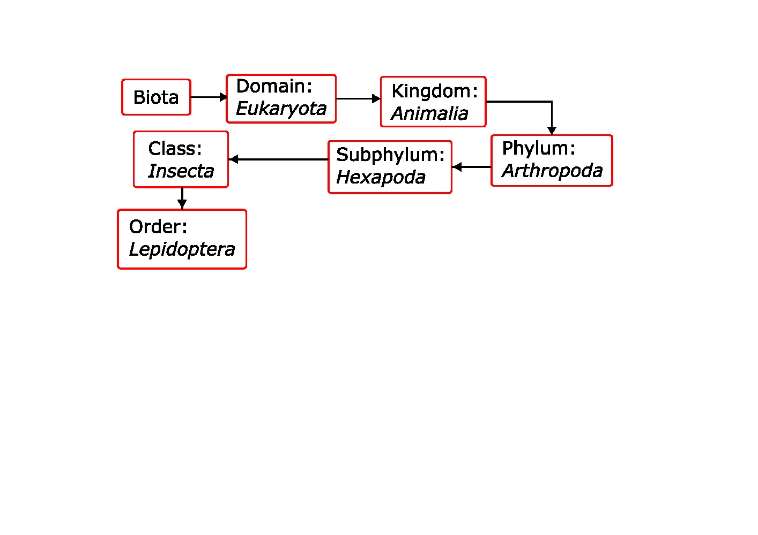
Checking The Basics
First check that our specimen is a moth.
This is not as daft as it sounds as it is not unheard of for a Caddis (Order: Trichoptera) to be queried as a moth.
In this case the overall appearance is definitely Lepidoptera.
Tree of life (biology)

Slide 9
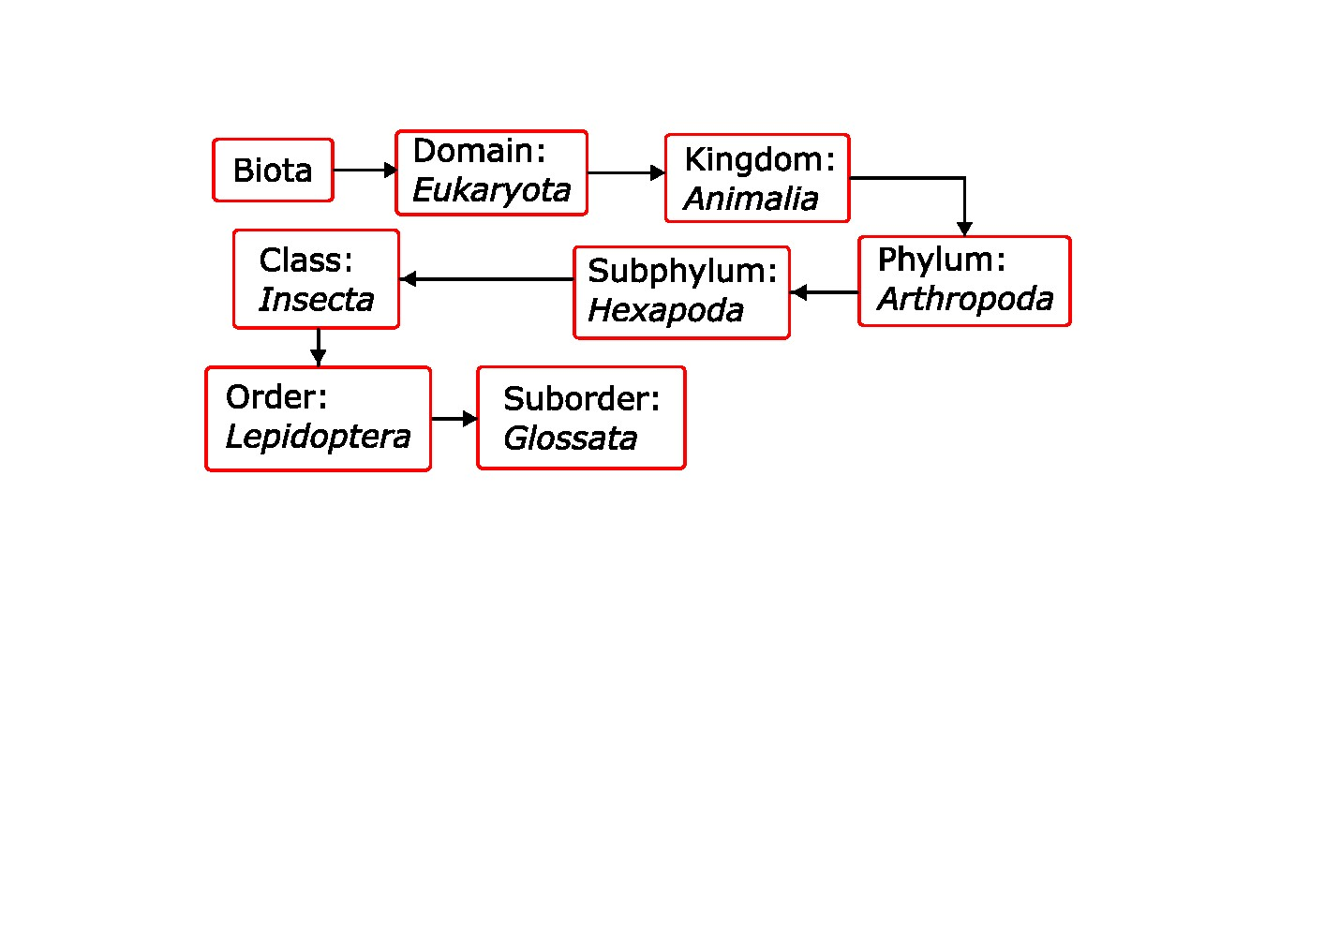
Checking External Features
All the short jawed Lepidoptera are micro moths, so it is quite likely that you will come across them, especially those that might be tricky to ID.
This specimen has a long coiled tongue, rather than short jaws, as have the majority of the Lepidoptera.
The long coiled tongue means that this moth is a member of the Glossata.
Tree of life (biology)

Slide 10
Getting To The Family 1
The face has a distinctive ‘nose’ and face. Also the antennae are laying flush along the body:
This is a member of the Pyraloidea super-family.
Note the posture.

Slide 11
Getting To The Family 2
The face has a distinctive ‘nose’ and face. Also the antennae are laying flush along the body:
This is a member of the Pyraloidea super-family.
The Pyraloidea are very variable but we can see that the long wings can wrap tightly around the body. Colloquially these are known as ’Grass moths, which are a member of the subfamily Crambinae.
Note the posture.

Slide 12
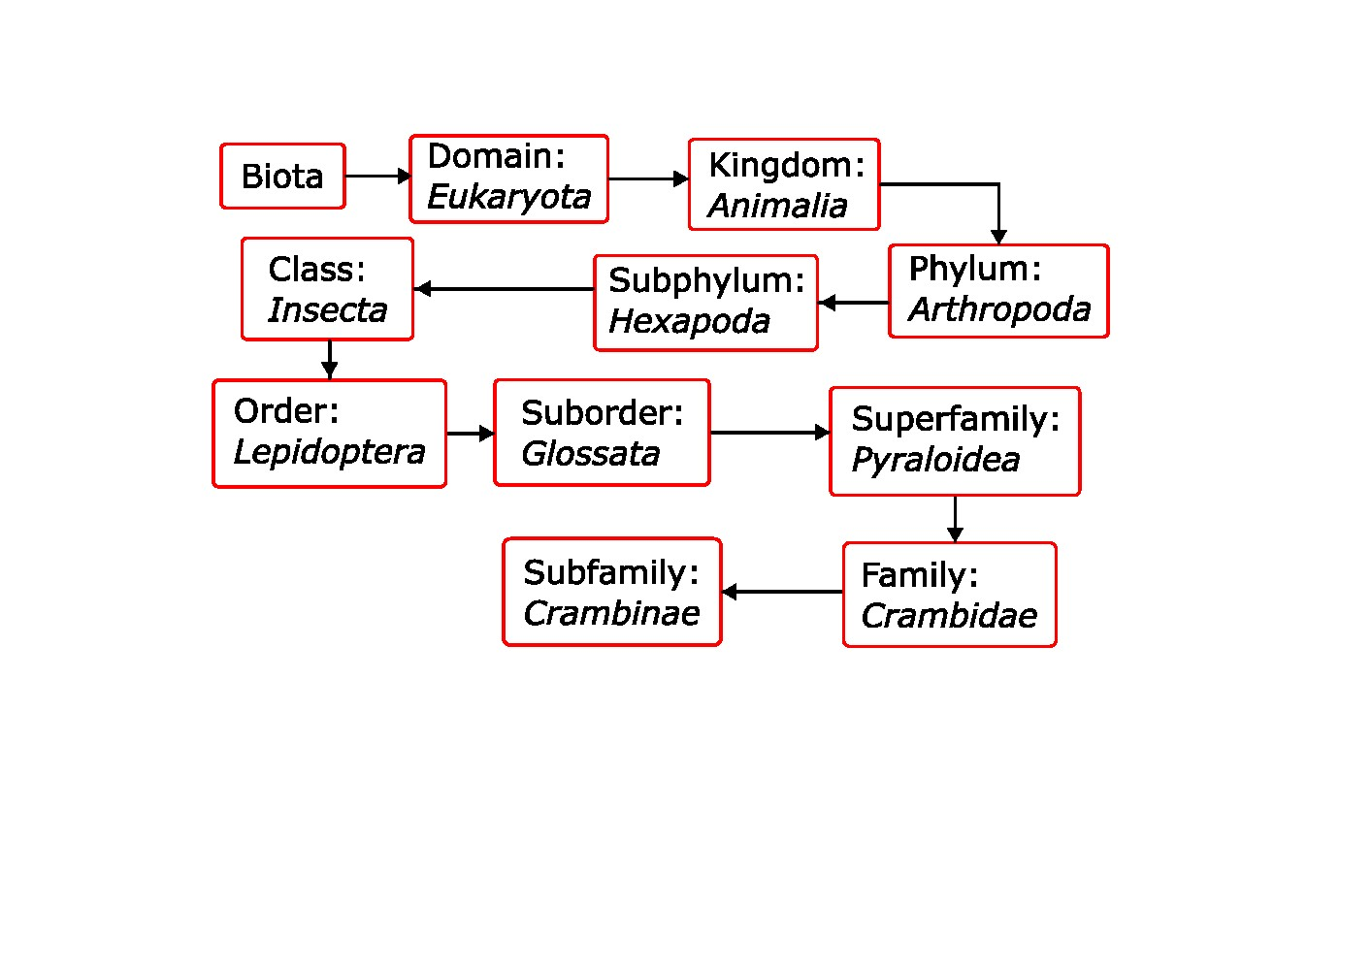
Getting To The Family 3
The face has a distinctive ‘nose’ and face. Also the antennae are laying flush along the body:
This is a member of the Pyraloidea super-family.
The Pyraloidea are very variable but we can see that the long wings can wrap tightly around the body. Colloquially these are known as ’Grass moths, which are a member of the subfamily Crambinae.
We have reduced the number of candidate species to about 17.
The Natural History Museum further subdivide this group into tribes, but these do not seem to be in general use.

Slide 13
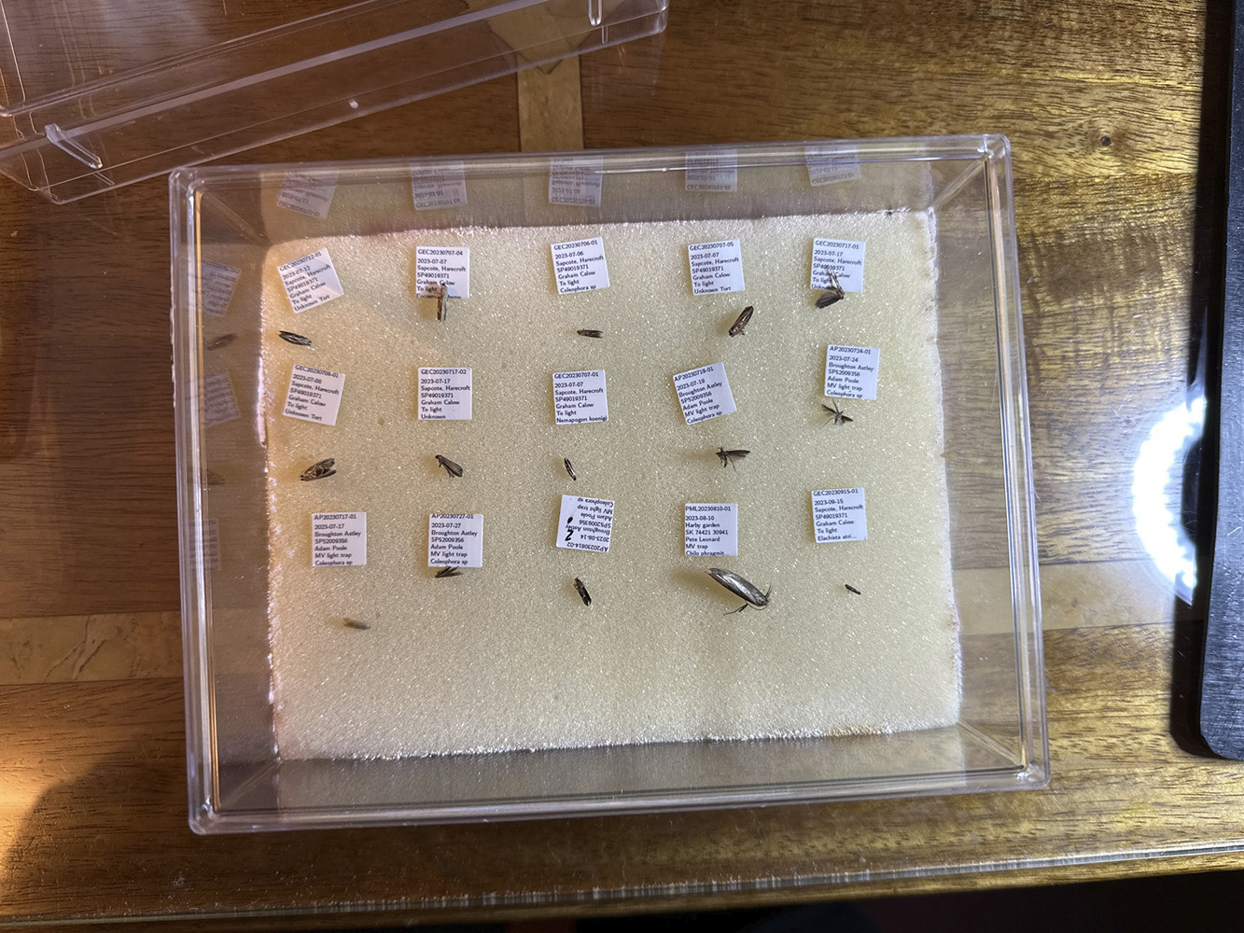
Confirming the ID
We have gone as far as we can with external features.
The way forward is examination of the genitalia - GenDet.
We start by relaxing the dead moth
Relaxing chemicals are water based.

Slide 14
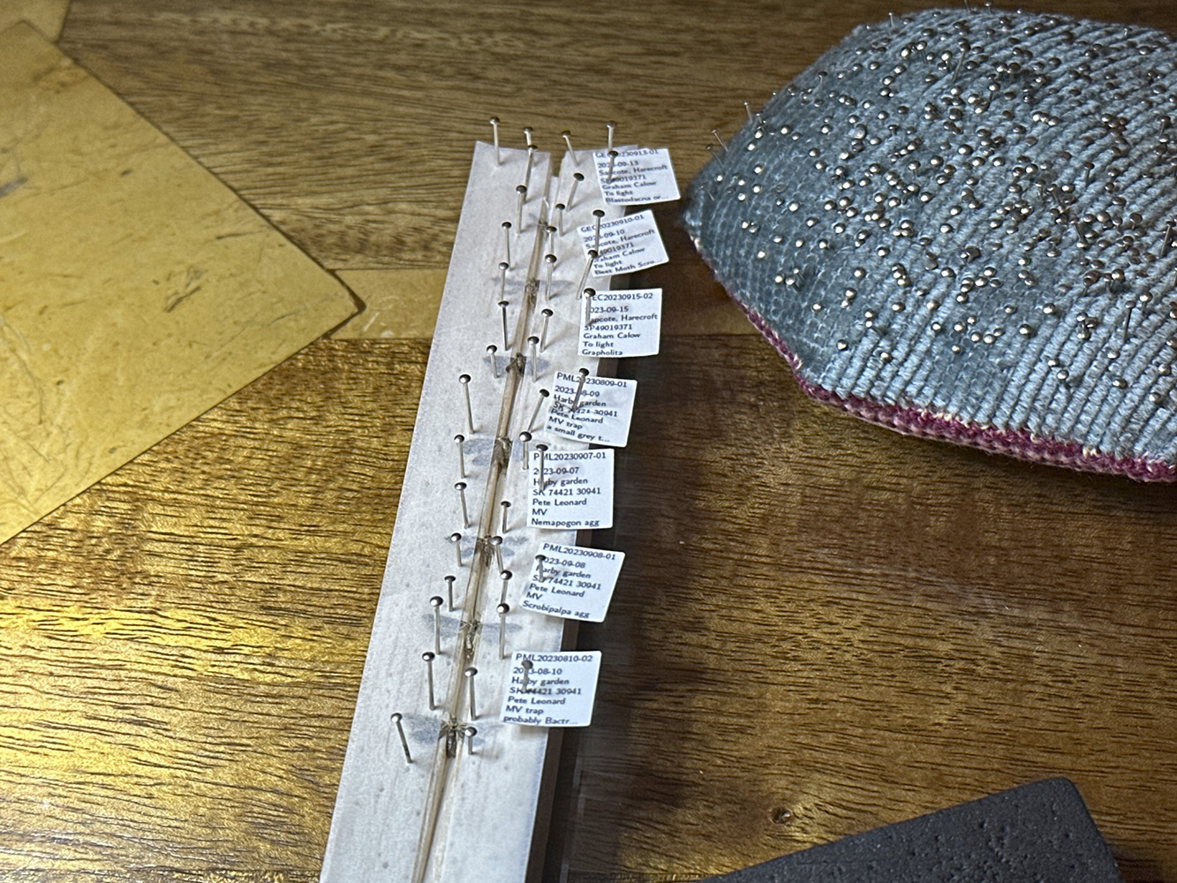
Setting
The relaxed moth is pinned and spread on a setting board.
Note how everything is carefully labelled.
It is then dried for a couple of weeks.
This process allows us to preserve as much of the specimen as possible.
A group of moths on the setting board.

Slide 15
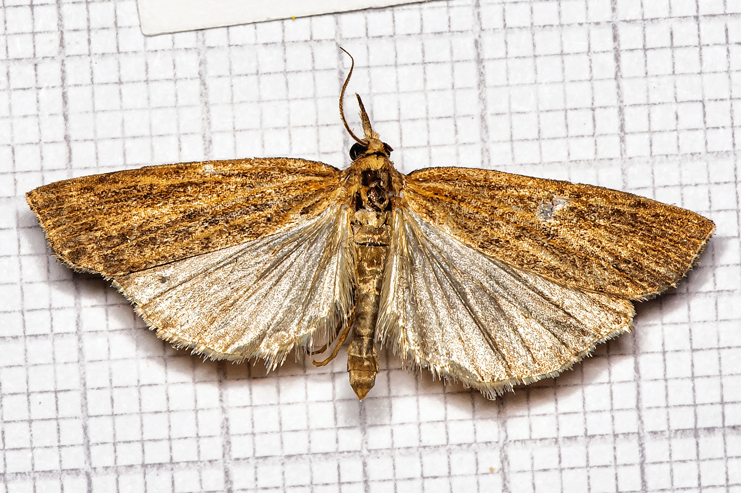
The Set Specimen
This specimen was fairly battered when it was received.
Often the set moth reveals much more detail for ID, especially in obscurely marked moths.
The wings still look very plain.
The set moth does not reveal any useful features for ID.

Slide 16
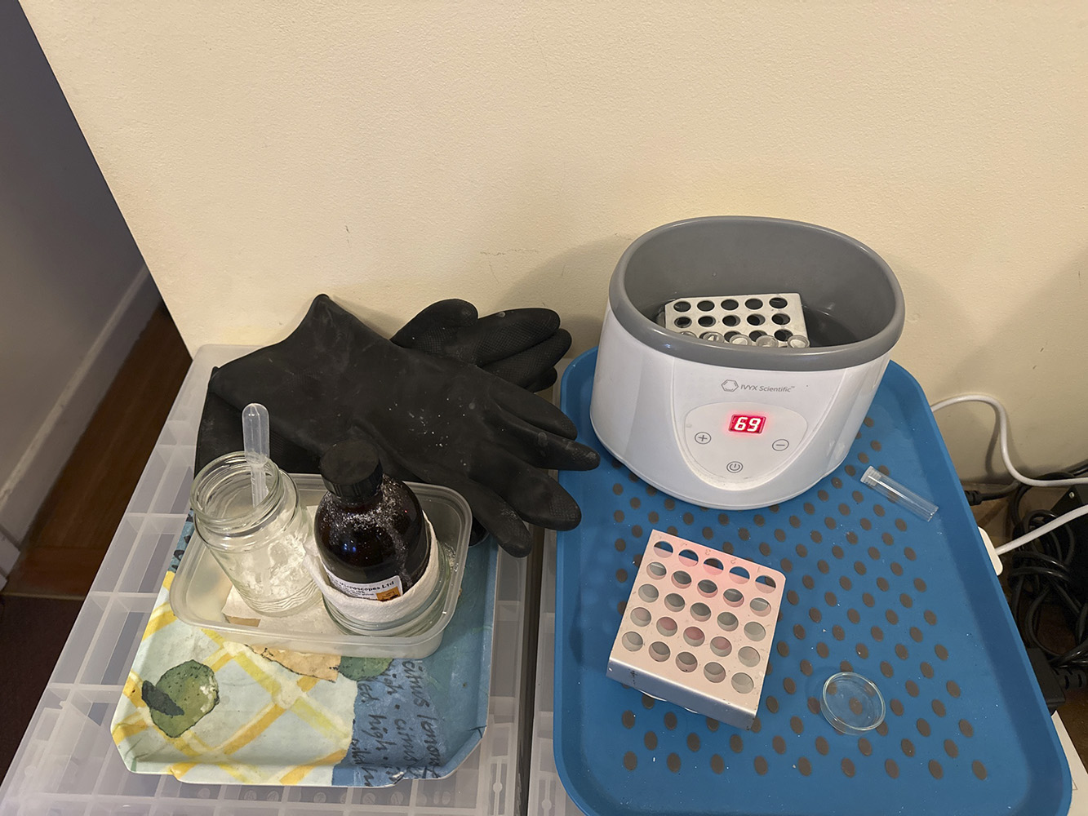
Clarification
The abdomen is removed from the moth and ‘cooked’ for 30 minutes at 70 degrees in 10% KOH.
A label is place in the tube using paper and ink that can survive this process.
A body swap would be a disaster.
Equiment used for clarification

Slide 17
This process is loosely called clarification as it dissolves the soft tissues. Different authors use the term to describe rather different processes.

Slide 18
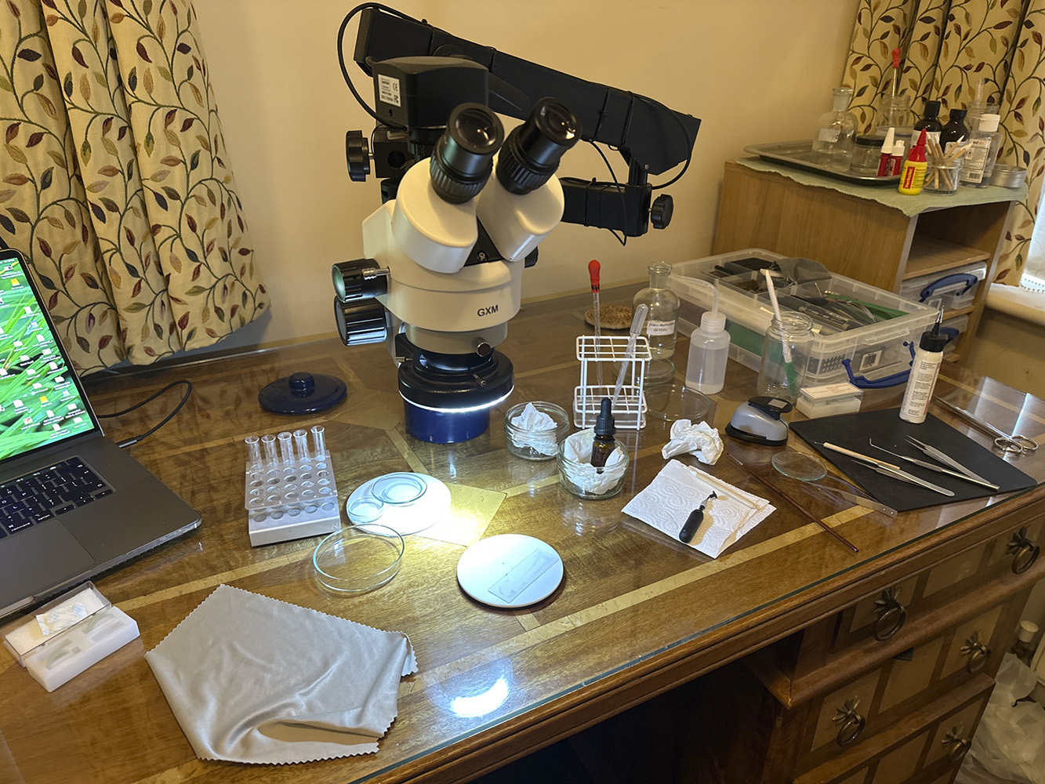
Dissecting
The genitalia are very small so a range of bought and home-made tools are used to dissect out the parts needed.
The parts are very fragile, so you only get one chance on a moth this size.
No pressure when you are doing this for someone else!
The smaller the dissection the more important the work space.

Slide 19
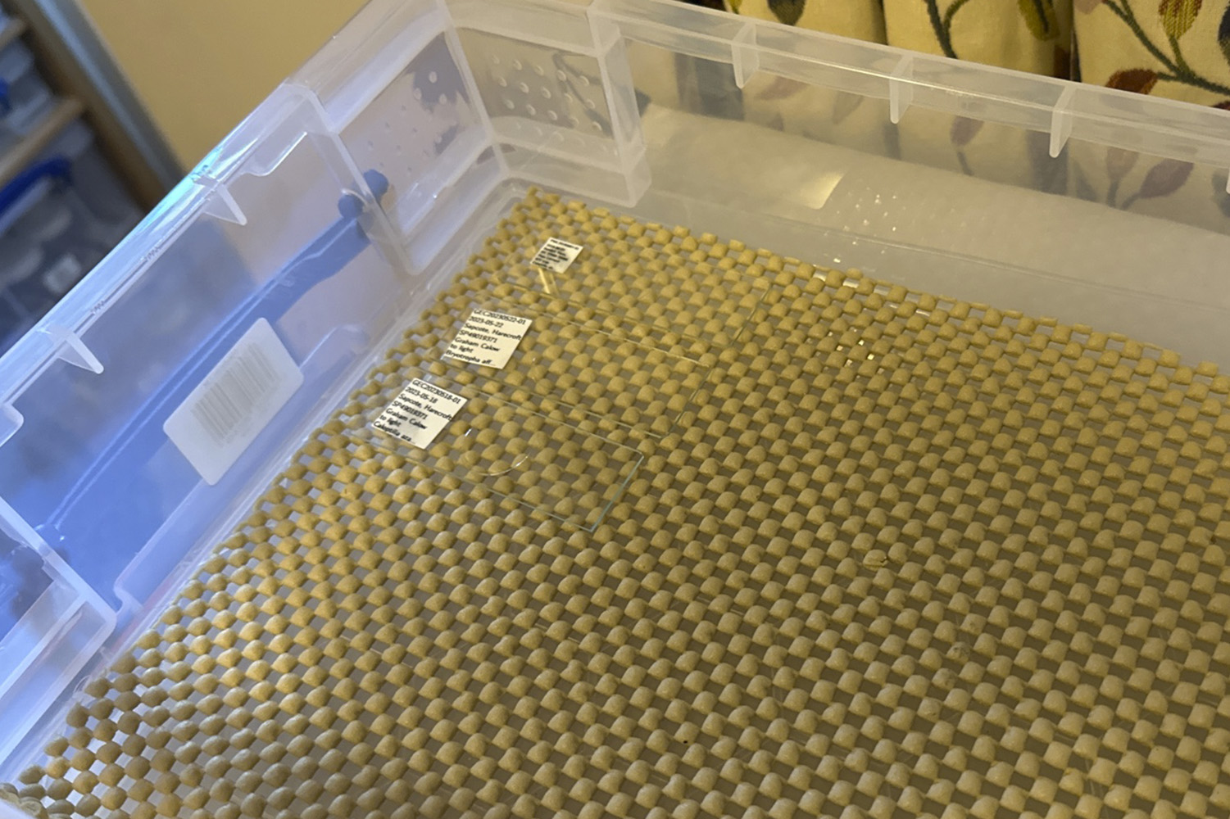
Mounting The Dissection
The parts are washed in de-ionised water.
Soaked in a little aqueous mountant.
Placed on a slide and a coverslip placed on top.
Finally, a temporary label is glued to the slide.
Slides are left for a few days to cure.

Slide 20
Alcohol based mountants are more difficult to use.

Slide 21
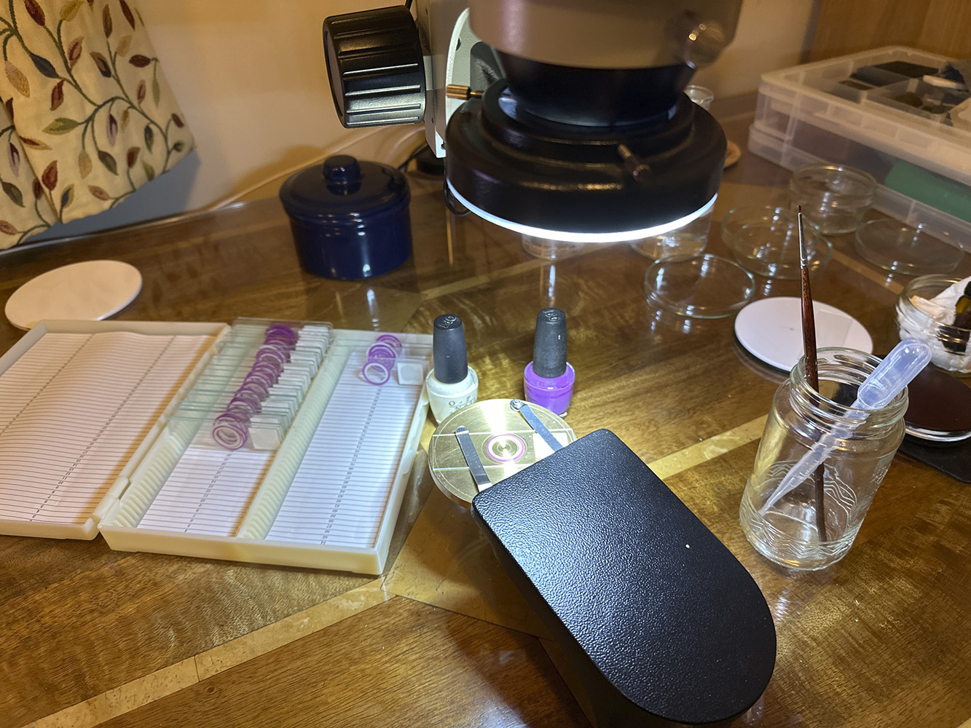
Ringing The Slide
Aqueous mountant slowly dries out, so needs to be sealed.
A ring of sealant will make the slide last many years.
A paintbrush is used to apply the sealant while the brass wheel is spun by hand.
Acetone can be used to remove the seal if rework is required.
Good quality nail varnish works exceptionally well.

Slide 22
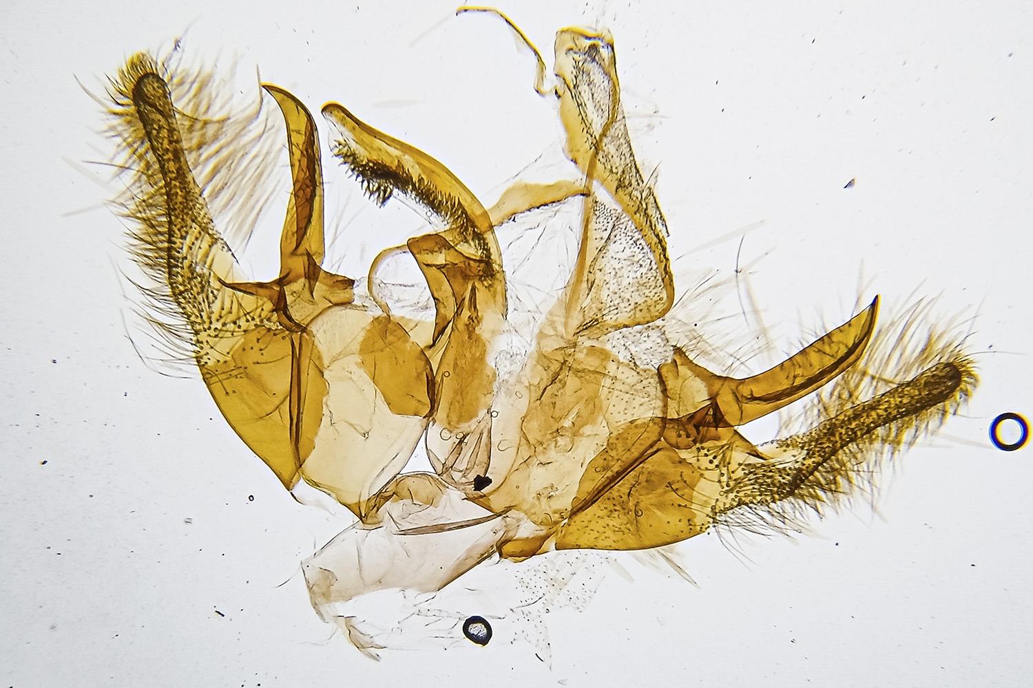
The Finished Dissection 1
The finished dissection is never perfect.
The final dissection image is more of an art form rather than a photograph.
Raw image

Slide 23
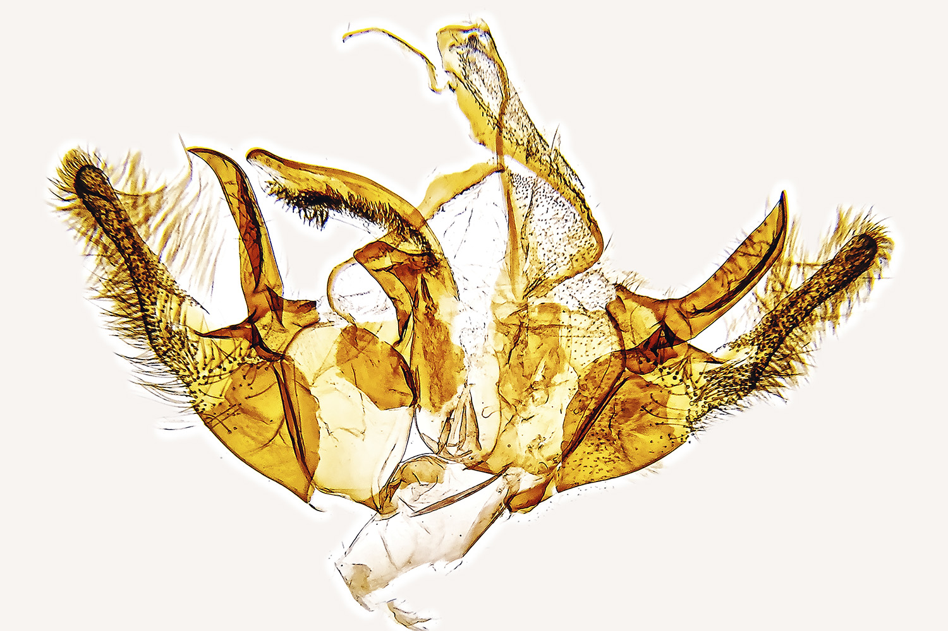
The Finished Dissection 2
The finished dissection is never perfect.
The final dissection image is more of an art form rather than a photograph.
An artist would eliminate the defects too, but don’t obscure critical features.
Cleaned image.

Slide 24
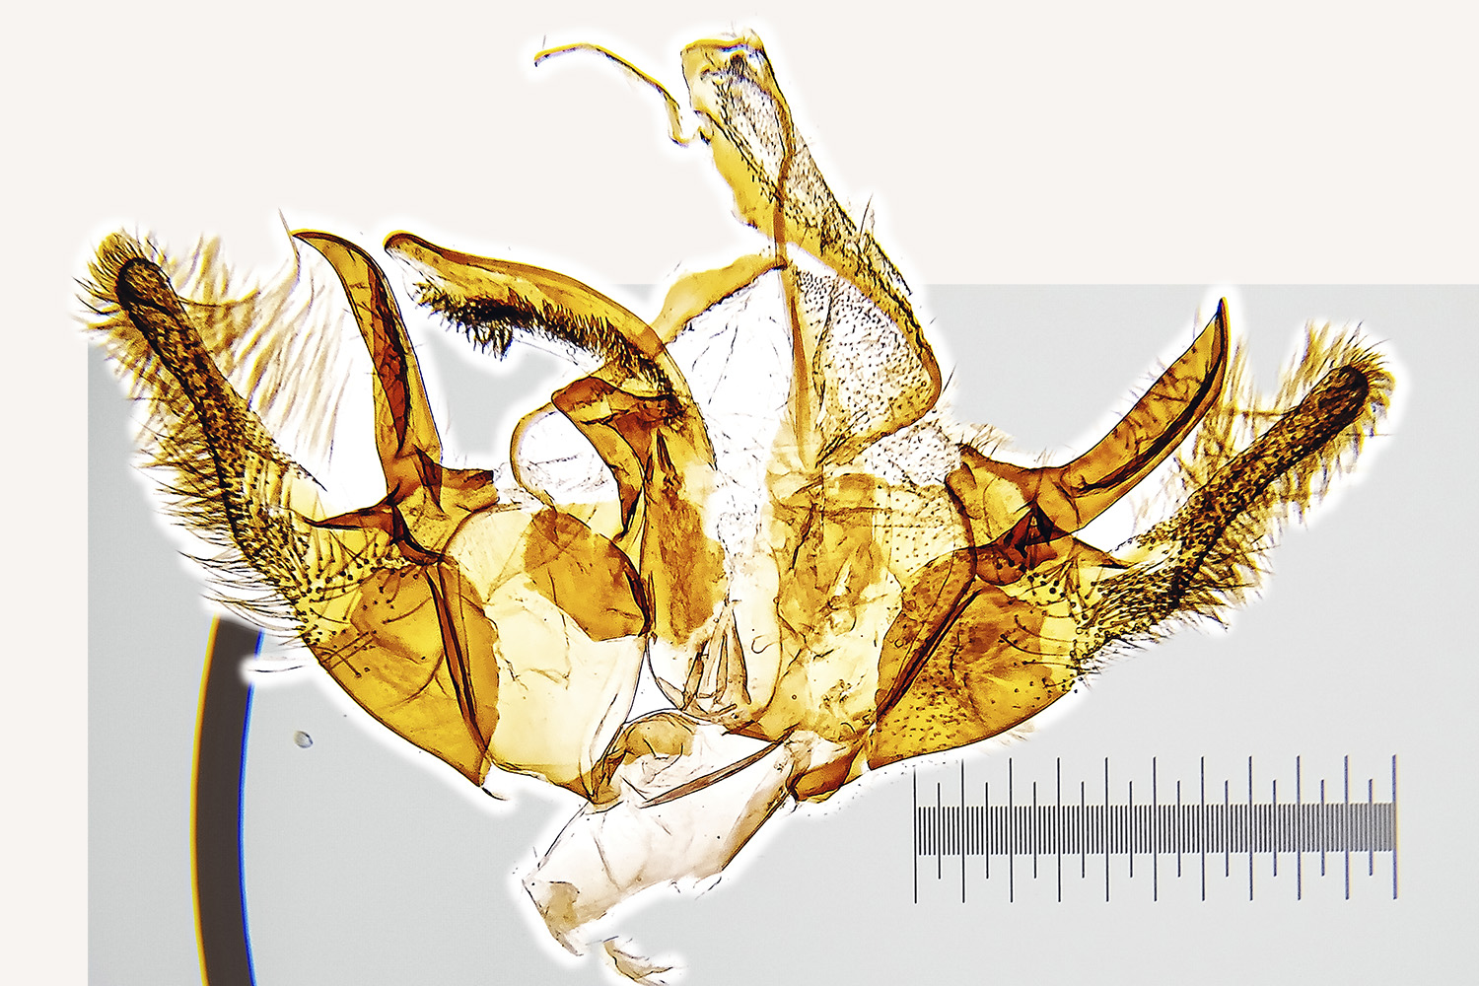
The Finished Dissection 3
The finished dissection is never perfect.
The final dissection image is more of an art form rather than a photograph.
An artist would eliminate the defects too, but don’t obscure critical features.
The scale is worked out by taking a photograph of a reference slide…..
Adding a scale.

Slide 25
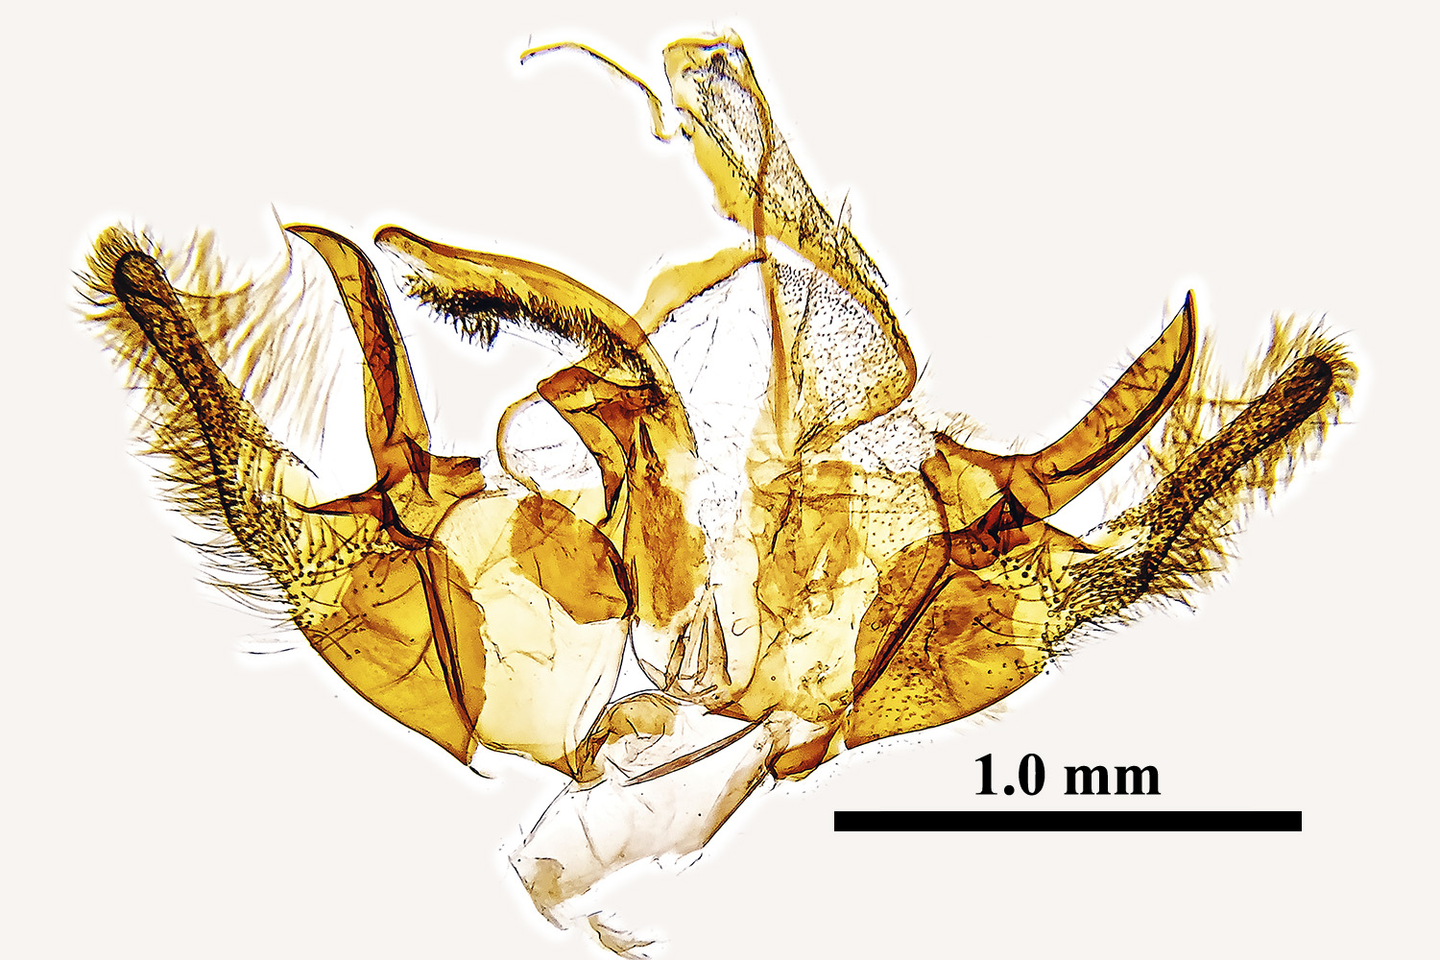
The Finished Dissection 4
The finished dissection is never perfect.
The final dissection image is more of an art form rather than a photograph.
An artist would eliminate the defects too, but don’t obscure critical features.
The scale is worked out by taking a photograph of a reference slide…..
Overlaying the photographed scale allows us to draw a nice reference line.
The developed image.

Slide 26
Review Everything We Know About The Specimen
Date: 2021-07-25, VC55; Recorder: Pete Leonard; Size: FL 12 mm.
Could this be Pediasia contaminella which is rare in VC55?
This specimen lacks the cross lines the dark point in the discal region typical of Pediasia contaminella.
But Pediasia contaminella said to have a distinctive upwards resting posture.
The set moth does not reveal any useful features for ID.

Slide 27
Specimens seen in Sussex by PJP were all well marked and instantly recognisable in both posture and appearance.

Slide 28
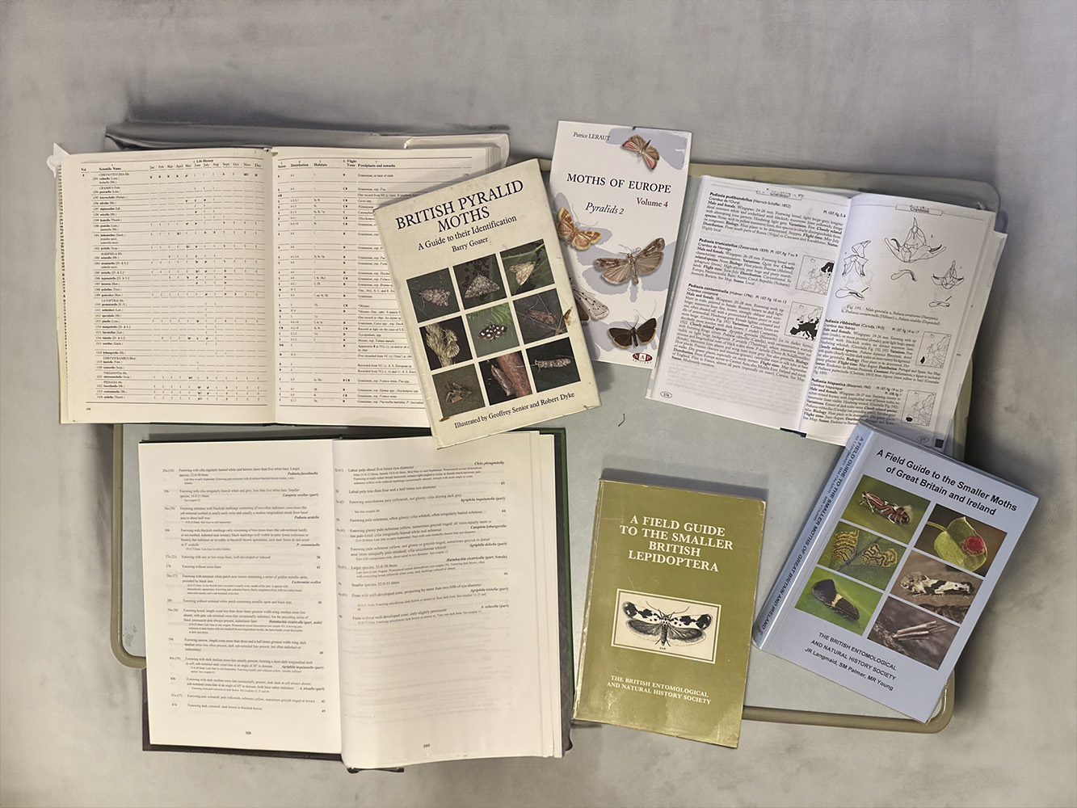
Using The Dissection For ID
Check the dissection against multiple sources as this specimen is not typical.
https://mothdissection.co.uk
https://lepiforum.org
Ask someone who is familiar with the species.
Books often contain useful comments about variations.

Slide 29
Checking The ID
The dissection matches Pediasia contaminella and is distinct from other members of the genus.
We need to eliminate related species not on the UK list as the specimen is not typical.
In this case we find no other candidates other than: Pediasia contaminella.
The horned processes and aedeagus are typical for Pediasia contaminella.

Slide 30
Summary
Identification of a tricky specimen is a tedious process.
Most of the time it turns out to be an unusual form of a common species as moths are very variable in size and wing pattern.
Environmental stress can cause size and colour variations.
Confirming the ID of something unusual requires the collation of a lot of evidence.
We still need to check books and published papers.

Slide 31
But sometimes you get lucky and it is a new record for the county!

